Slide 1
An
API-FIRST
Approach
The Best Approach for API Development
Notes:
Start with a question or motivating example
Why is what you are doing important?
Why should people care?

Slide 2

About me
Name: Ho Minh Chung
Badge ID: 143714
Group: Web Team-AxS Modelling-DC9-DG4
Email: hmchung@tma.com.vn

Slide 3
Agenda
Problems in API development
How to Resolve the problem?
Q&A

Slide 4
Problems in API development
1
Code-first approach (current approach)
The problem with code-first approach

Slide 5





Current problems in API development?
Code First Approach
Business
opportunity
Strategic
documentation
Task
assignment
Code
the API
Contract/
Documentation
Code First Approach
Notes:
Do you have any problem that we r facing in current approach?

Slide 6
Current problems in API development?
The Problem with Code First approach
Situation
Code First Approach
Issues
Team interdependence
Late detection of issue
Implementation
of
New Features
Inconsistency in design
Error-prone
Code the API
Contract
Labor-intensive
Breaking capacity
Notes:
difficult to handle

Slide 7
How to Resolve the problem?
2
Change the current approach
Use new technologies

Slide 8
2.1 Change the current approach
Using design-first approach
Code-first vs design-first
The benefits of design-first approach
Notes:
Review the layout of the slides

Slide 9
Change the current approach
Using design-first approach
Business
opportunity
Strategic
documentation
Task
assignment
Contract/
Documentation
Code the API
Design First Approach

Slide 10

Change the current approach
Code First vs Design First
Code First
VS
Design First
Web
Client
Android
Client
IOS
Client
Web
Client
Android
Client
IOS
Client
3
2
SDK
SDK
SDK
SDK
SDK
SDK
Front-end teams
API
API
API
1
Mock
Mock
Mock
2
Impl
Impl
Impl
2
API
Back-end teams
Impl
1
Data
Services
Notes:
- The Code First approach is more traditional approach to building APIs, the implementing of code happening after the business requirements are provided, and generating documentation from the code.
- The Design First approach is designing the API’s contract fist before writing any code. This is a new approach, it is fast catching on, especially with the use of API description formats.
Your API specification provides a contract that describes what a successful response will look like when someone calls your API.
With an API specification, development projects that involve multiple teams( backend, web, mobile, etc) can proceed much better than traditional methods would allow.
- Front-end teams can immediately start building components that dont need to wait backend components are ready because we can generate and run mock services based on an API specification.
- Team can work independently/parallel (ˈpærəlel / song song), without having to wait for a member to complete a step first.

Slide 11
Current problems in API development?
The Benefits of Design First Approach
Situation
Design First Approach
Issues
Provide Feedback
Implementation
of
New Features
Consistent Design
Immediately Interact
Contract
Code the API
Identifying Issues
Notes:
difficult to handle

Slide 12
2.2 Use new technologies
Swagger Editor
Swagger Codegen
Swagger UI
Swagger Inspector
Notes:
5s for each introduction slide

Slide 13




Use new technologies
Swagger Tools
Design
Build
Document
Test
Swagger Editor
Swagger Codegen
Swagger UI
Swagger Inspector
Design & model APIs
Generate client & server code
Visualize & Interact with the API’s
API Testing & Documentation Tool
Notes:
Swagger project is open source and sponsored by SMARTBEAR
Swagger Core Java-related libraries for generating and reading Swagger definations
Swagger Editor lets you edit OpenAPI specifications in YAML inside your browser and to preview documentation in real time.
Swagger UI allows anyone (your team) to visualize and interact with the API’s resoruces without having any of the implementation logic in place.
Swagger Codegen command-line tool for generating both client and server code from a Swagger definition.
Swagger Inspector: API Inspection tool that lets you generate OpenAPI definitions from existing API.

Slide 14

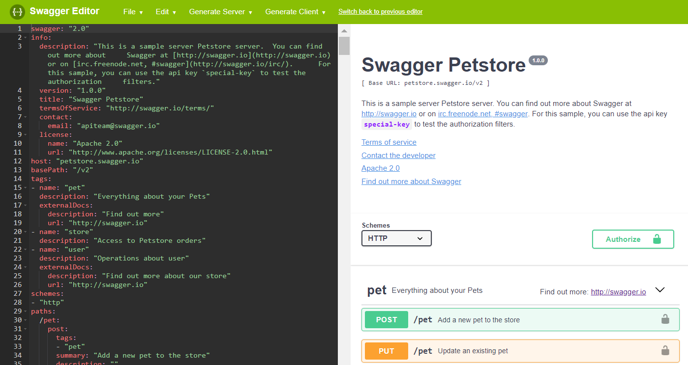

Technologies
Swagger Editor
Smart Feedback
Runs Anywhere
Easy-to-use
Intelligent
Auto-completion
Visually design your API without coding knowledge

Slide 15
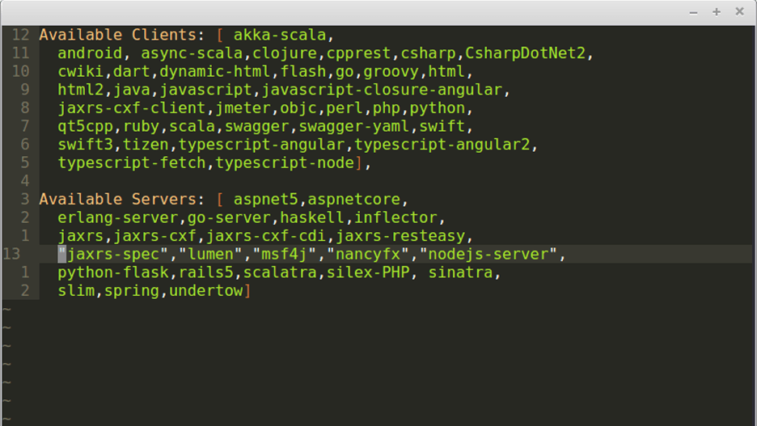
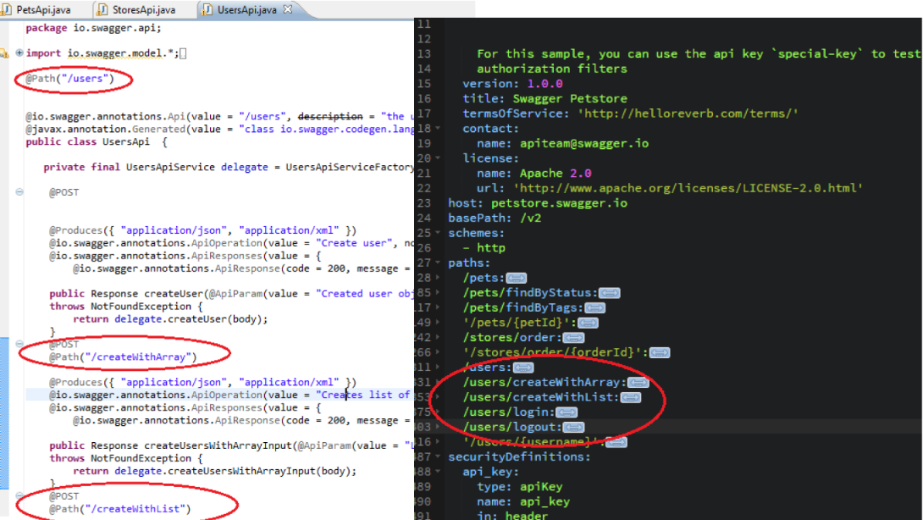
Technologies
Swagger Codegen
1
2
Generate Servers
Generate Client SDKs
Generating Server’s and Client’s code form spec
Notes:
Multiple languages

Slide 16
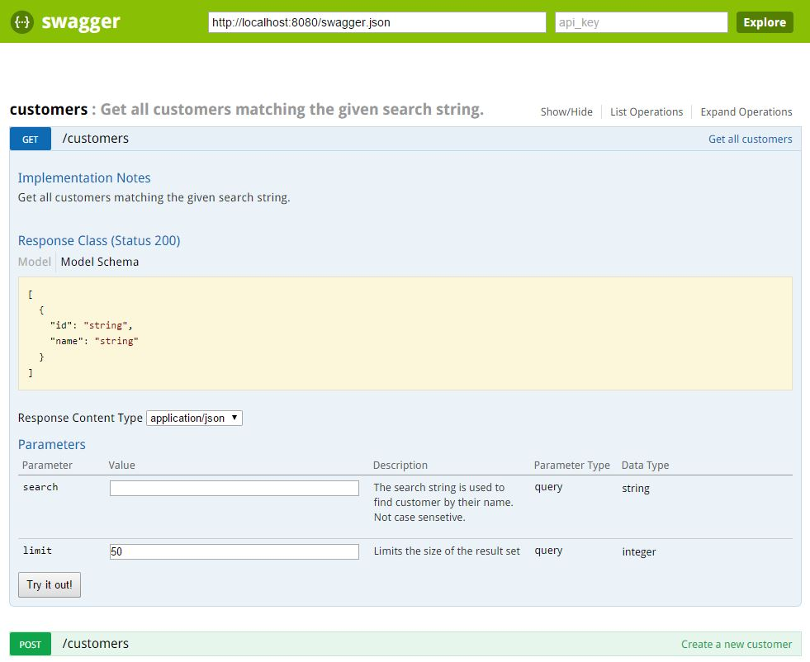
Technologies
Swagger UI
Human Friendly
Dependency Free
Easy to Navigate
All Browser Support
Automatically generated from your API Specification

Slide 17
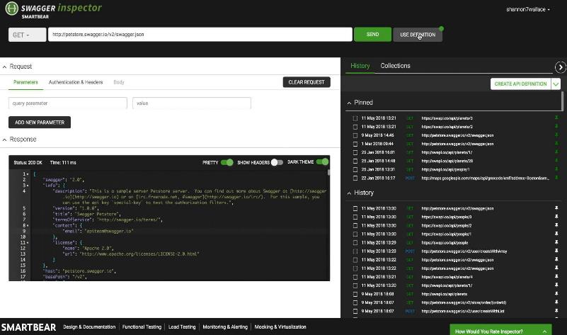
Technologies
Swagger Inspector
1
Validate Functionality
During Development
2
Explore API Capabilities
3
Automating API Testing
In SoapUI
Test without testing your patience

Slide 18
Q&A
3
Notes:
Provide summary/conclusions
Show how each of your main points support your overall argument
No way to Speed Up API Development

